Slide 1


Java ee
(ADVANCE JAVA)
Lecture-17

Slide 2
Today’s Agenda
Types of JSP Elements
Scriptlet Tag
Declarative Tags
Expression Tag

Slide 3
TYPES OF JSP ELEMENTS
A jsp page can contain various types of jsp based programming elements.
Each of these elements allow us to write java based statements in our page and are used to make our page dynamic.

Slide 4
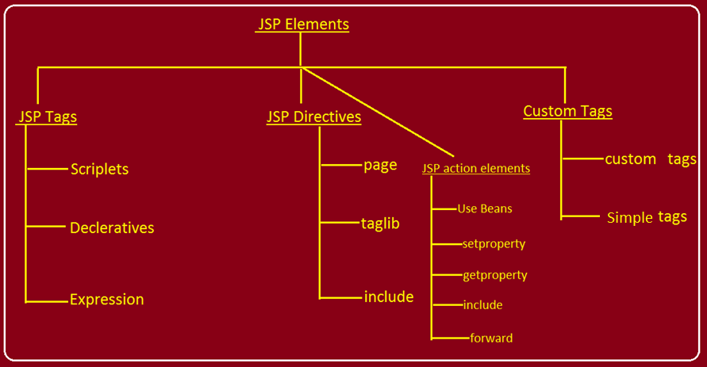
TYPES OF JSP ELEMENTS

Slide 5
JSP TAGS
Jsp tags are special tags given by JSP which allow us to insert Java code within a Jsp page .
Whenever the container translates a jsp page into a servlet then it places all the coding written within Jsp tags inside the methods :
jspInit( )
_jspService( )
jspDestroy( )

Slide 6
JSP TAGS
Jsp tags are broadly categorized to be of three types :
Scriplets tags
Declarative tags
Expression tags

Slide 7
SCRIPLETS
The scriplet tag allows us to embed java code within the jsp page i.e it makes our page dynamic.
Whatever code we write inside a scriplet gets pasted within _jspService ( ) method by the container .
The general syntax of writing scriplet is :
<%
// Pure Java Code
%>

Slide 8
SCRIPLETS
Example:
<%
String name=“Sachin”;
out.println(“Name is “+name);
%>

Slide 9
WHAT IS ALLOWED IN A SCRIPTLET?
We can do the following things in a scriptlet :
Declare variables .
Create objects of other classes .
Use built-in objects given by JSP .

Slide 10
WHAT IS NOT ALLOWED IN A SCRIPTLET?
Things we cannot do in a scriptlet are :
We cannot define a method in a scriplet
We cannot declare static variables in a scriplet
We cannot directly write html statements inside the scriplet but we can write them within the println method of the predefined object out .

Slide 11
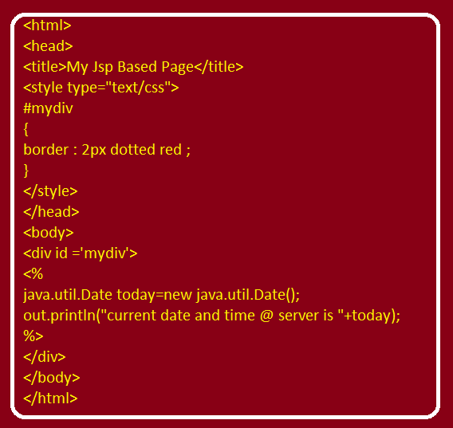
PROGRAM FOR DATE & TIME

Slide 12
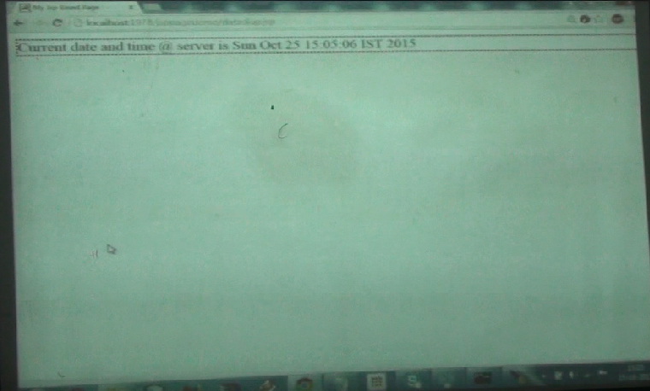
OUTPUT

Slide 13
EXERCISE
Write a JSP page which displays your name in all six headings

Slide 14
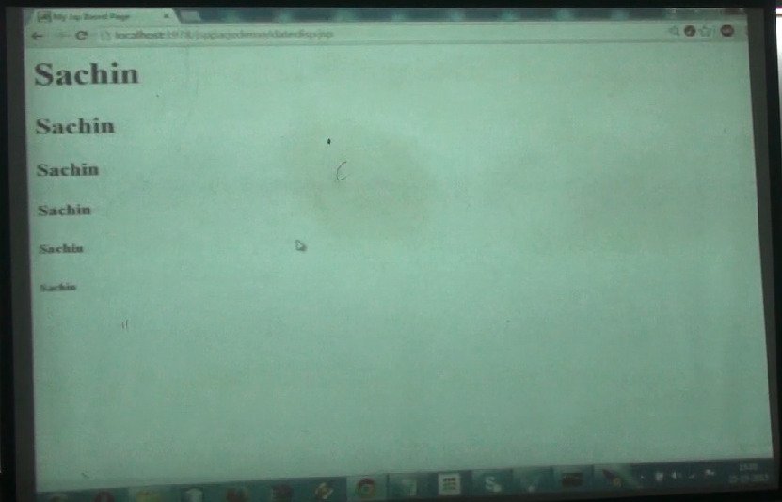
OUTPUT

Slide 15
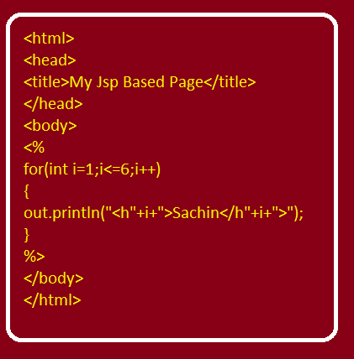
DISPLAY YOUR NAME IN HEADING

Slide 16
DECLARATIVE TAGS
The declarative tag also allows us to write pure java code in its body just like scriptlet .
Whatever we write in a declarative tag gets pasted above the _jspService( ) method .
The general syntax of declarative tag is :
<%!
//pure java code
%>

Slide 17
DECLARATIVE TAGS
Declarative tag just like scriplet tag allows us to write pure java code but whatever we write in a declarative tag gets pasted inside the class generated for the JSP page .

Slide 18
WHAT IS ALLOWED IN A DECLARATIVE TAG?
We can declare variables in declarative tag and can use them in scriplet .
EXAMPLE :
<%!
int a;
%>
<%
out.println(“a=“+a);
%>
Output:
a=0

Slide 19
WHAT IS ALLOWED IN A DECLARATIVE TAG?
We can define methods in a declarative tag and can then call it from scriplet .
EXAMPLE :
<%!
int cal(int i , int j ){
return ( i+j);
}
%>
<%
out.println(cal(5,7));
%>
Output:
12

Slide 20
WHAT IS ALLOWED IN A DECLARATIVE TAG?
We can use or create objects in a declarative tag and can use them in scriplet .
EXAMPLE :
<%!
java.util.Date today= new java.util.Date();
%>
<%
out.println(today);
%>

Slide 21
WHAT IS NOT ALLOWED IN A DECLARATIVE TAG?
We cannot use predefined objects given by JSP like out,request,response,session etc. in a declarative tag because these object are created inside _jspService ( ) method by JSP .

Slide 22
EXERCISE
Write a JSP page which displays number of times it has been accessed.

Slide 23
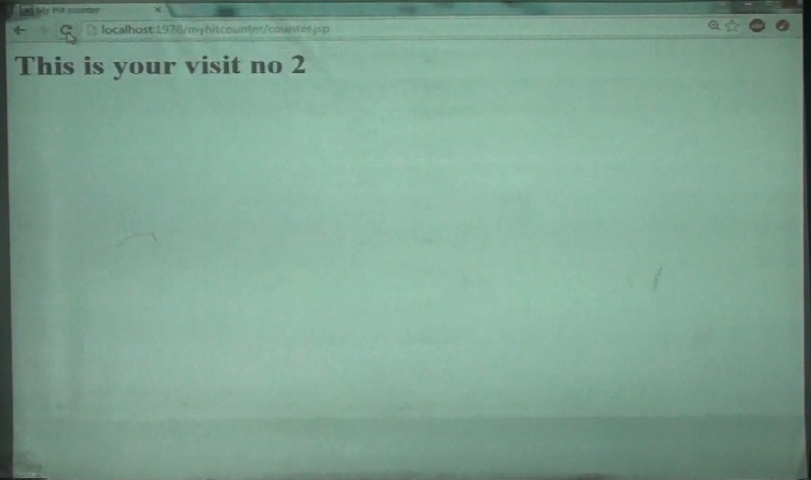
OUTPUT

Slide 24
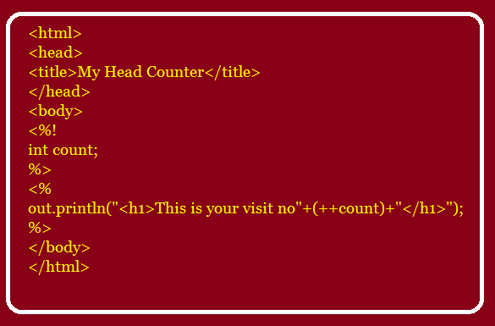
PROGRAM My Hit Counter

Slide 25
EXPRESSION TAG
The expression tag allows us to write any valid java expression and whatever we pass to expression tag is transferred as argument to out.print ( ) method inside _jspService( ) method’s body.
The general syntax of expression tag is :
<%= Java expression %>

Slide 26
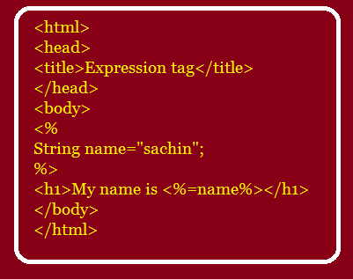
EXAMPLE

Slide 27
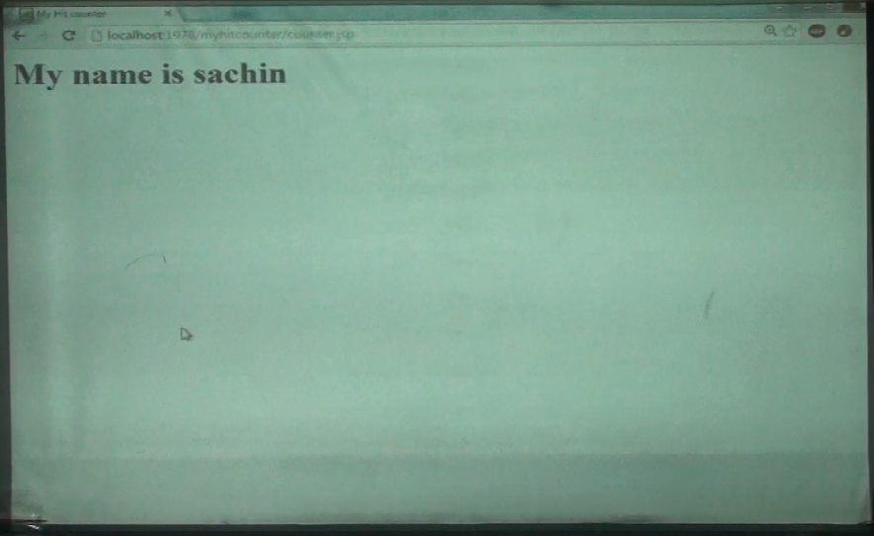
OUTPUT

Slide 28
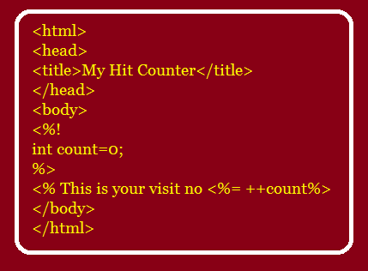
HIT COUNTER USING EXPRESSION TAG

Slide 29
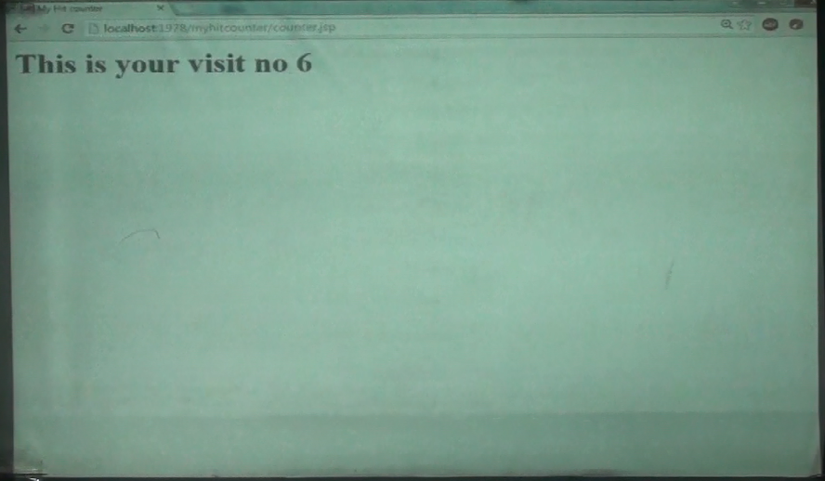
OUTPUT

Slide 30

End Of Lecture
For any queries mail us @: scalive4u@gmail.com
Call us @ : 0755-4271659, 7879165533
Agenda for Next Lecture:
Implicit Objects In JSP page
Comments
The MVC Model

